Slide 1

Scaffold Fabrication Strategies for Wound Healing By: Morteza Khodaei Supervisor: Dr. Mehdinavaz Spring 2025
School of metallurgy and Material science, University of Tehran

Slide 2
Table of contents
01
02
03
04
Introduction
Methods
Case Studies
Conclusion & Summary

Slide 3
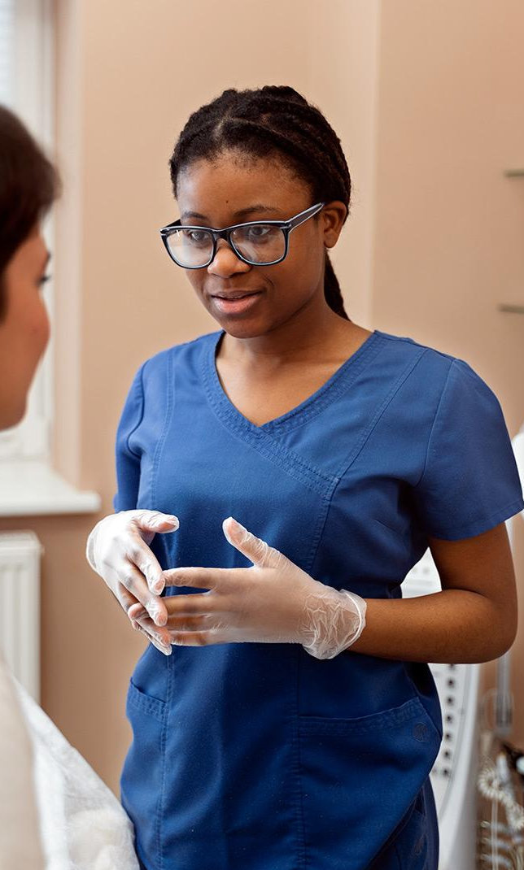
01
Introduction

Slide 4
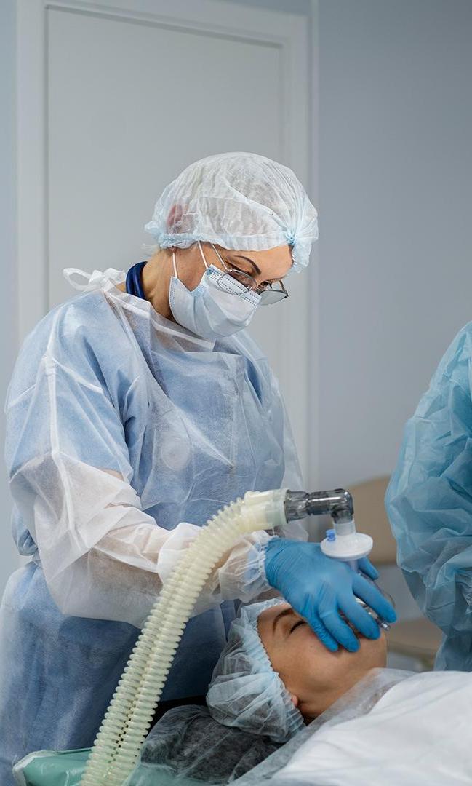
Background on Wound Healing
Chronic wounds and surgical scars pose significant medical challenges
Scaffold-based strategies are promising for enhanced healing
Aims: mimic ECM, support cell activity, and control healing environment
1

Slide 5
What Makes an Ideal Scaffold
Bio-compatibility
Drug loading capacity
High porosity
Bio-degradability
Inter-connectivity
Mechanical stability
2

Slide 6
02
Methods

Slide 7
Fabrication Methods
Freeze-drying
Electrospinning
3D Printing
Simple
Cost-effective
High porosity
Poor control
Drug loaded hydrogel
Produces ECM-Like nanofiber meshes
Good for surface interactions
Limited mechanical strength
High reproducibility in 2D/3D mats
Layer-by-layer precision
Multi-material and cell incorporation
Custom design for complex wound shapes
High cost
high potential
3

Slide 8
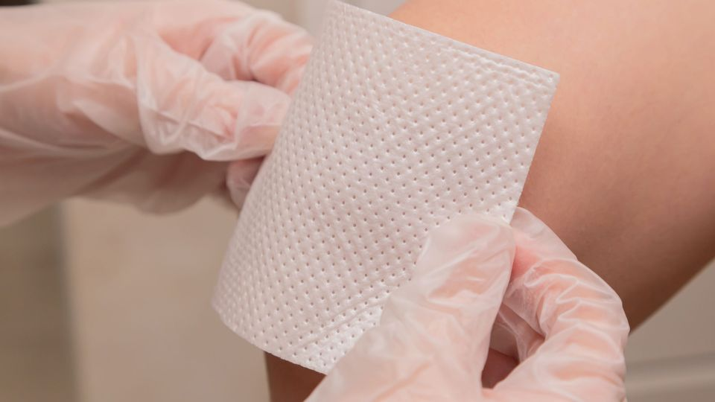
03
Case Studies

Slide 9
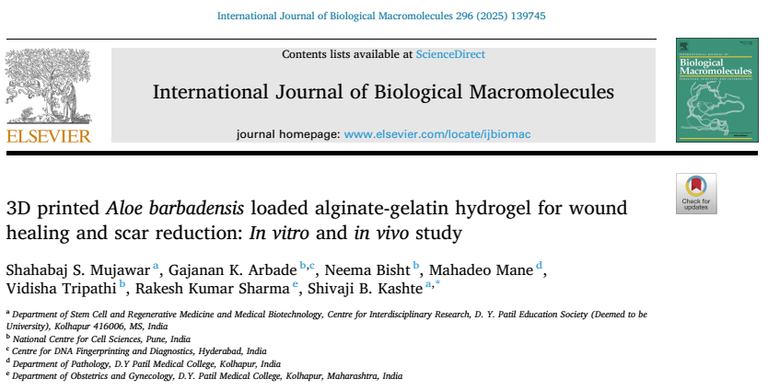
Case Studie 1: 3D printed Aloe barbadensis loaded alginate-gelatin hydrogel
4

Slide 10
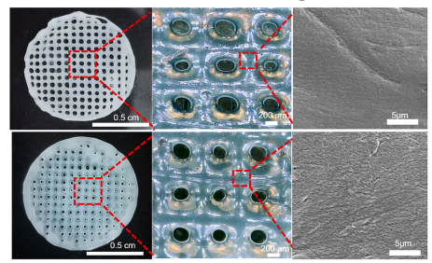
Case Studie 1
Porous and interconnected structure facilitating cell infiltration
SEM Images of 3D-Printed ALG-GE-AVE Hydrogels
5

Slide 11
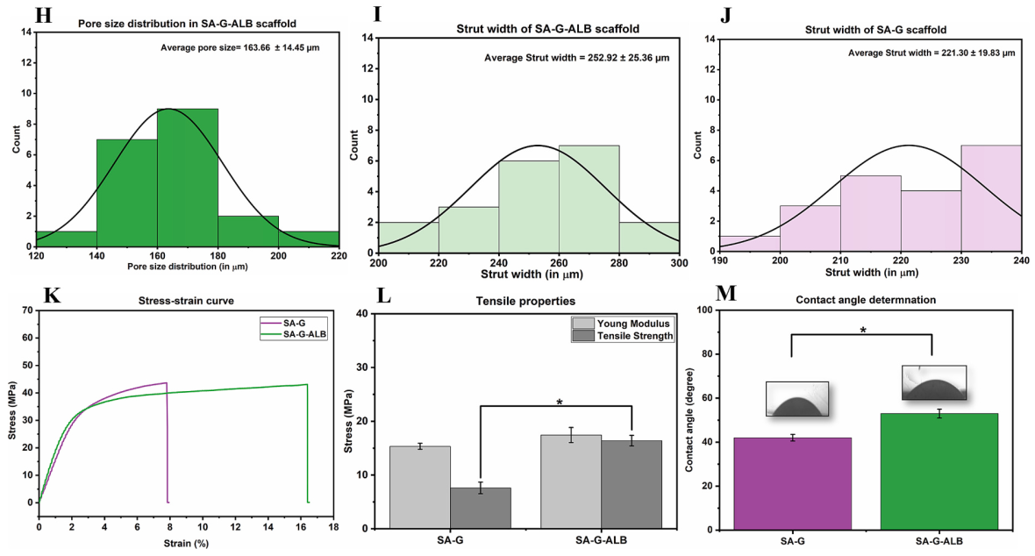
Case Studie 1
H) Histogram of the average pore size distribution of SA-G-ALB scaffold, I) Histogram of the average strut width of SA-G scaffold, J) Histogram of the average strut width of SA-G scaffold, K) Stress-strain curve of both SA-G and SA-G-ALB scaffolds L) Mechanical properties of both SA-G and SA-G-ALB scaffold.
6

Slide 12
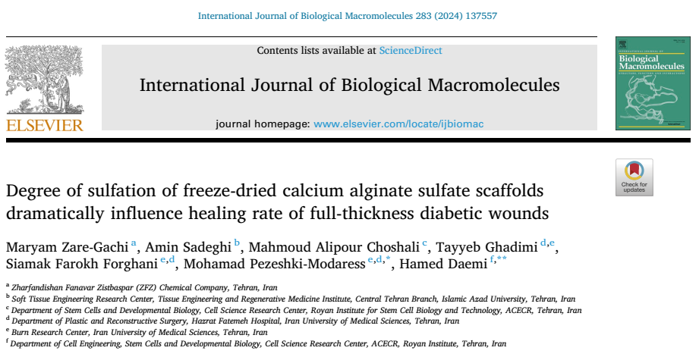
Case Studie 2: Degree of sulfation of freeze-dried calcium alginate sulfate scaffolds
7

Slide 13
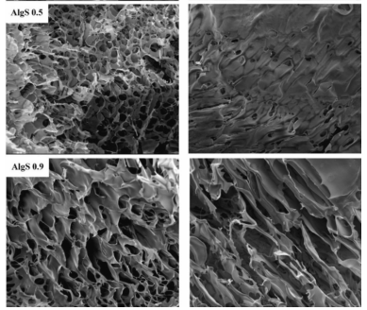
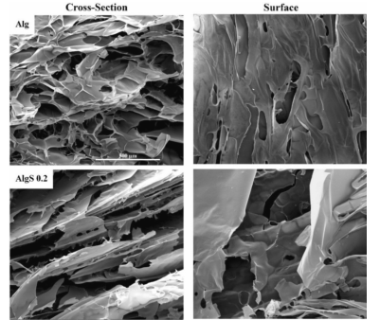
Case Studie 2
SEM images of the surface and cross-section of neat alginate and its sulfated derivatives
11

Slide 14
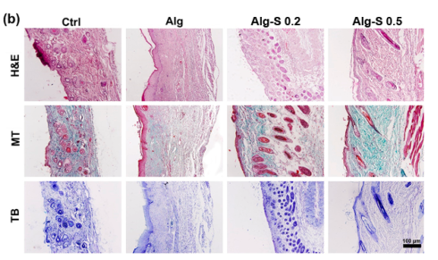
Case Studie 2
(b) histological analysis of H&E staining of samples to reveal the formation of epidermal layer, MT staining to show the collagenous layer (green) and TB staining to indicate the presence of inflammatory cells in the wound (black marker). (Scale bars = 100 μm, and n = 4 for each group per time point).
Histological analysis of H&E (epidermal layer), MT (collagen layer, green), and TB (inflammatory cells, black) staining
12

Slide 15
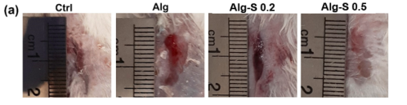
Case Studie 2
Wound Closure (%) | Group
50% | Ctrl
60% | Alg
80% | Alg-s 0.2
90% | Alg-s 0.5
Macroscopic images of wound closure across different treatment groups on day 20
13

Slide 16
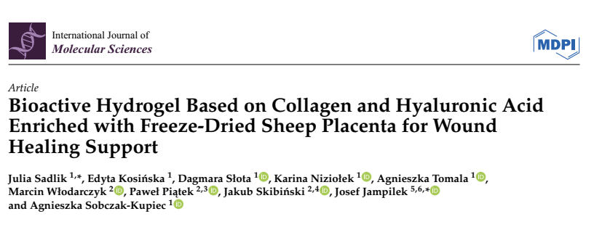
Case Studie 3: Bioactive Hydrogel Based on Collagen
10

Slide 17
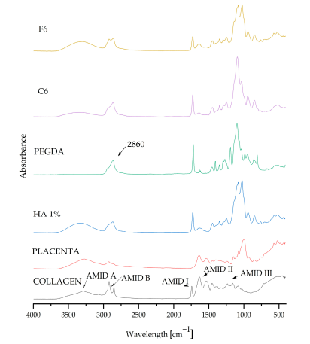
Case Studie 3
8

Slide 18
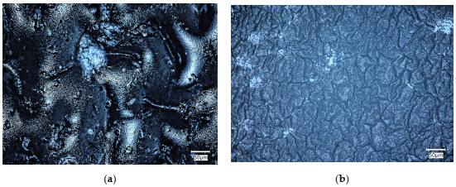
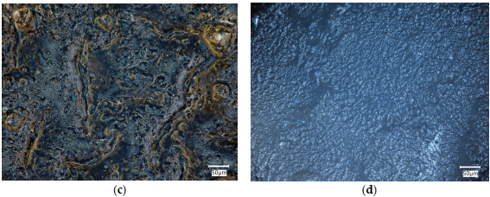
Case Studie 3
Microscopic images of C6 (a,b) and F6 (c,d) samples before (a,c) and after (b,d) incubationin SBF solution
9

Slide 19
04
Conclusion & Summary

Slide 20
Conclusion & Summary
Case Study | Scaffold Type | Fabrication method | Outcome
Alginate Sulfate (2024) | Freeze-dried porous scaffold | Freeze-drying | Enhanced healing, ↓ inflammation (↓TGF-β)
Aloe-Loaded Alg-Gel (2025) | 3D printed biohydrogel | 3D Bioprinting | Accelerated closure, ↓ scar formation
Collagen/HA + Placenta (2025) | ECM-mimetic hydrogel | Freeze-drying | Improved hydration, re-epithelialization
14

Slide 21
Thanks

